Slide 1
Realizing
Database-as-a-Service with
Tungsten Enterprise
Edward Archibald
CTO
Continuent
Notes:
1
Notes here.

Slide 2
Topics
What does Database-as-a-Service (DBaaS) mean?
Demo of Tungsten Enterprise
The Foundation:
Consistent Copies Maintained by Tungsten Replicator
The Data Service:
Logical to Physical Mapping via the SQL Router
Monitoring and Complex Process Orchestration
Just Around the Corner: Tungsten 2.0 Preview
Getting Started with Tungsten Today
Notes:
2
Todays session is very straightforward
Bullets
During todays session you may submit questions at any point during the presentation by using the Q&A box on the lower right of your webex screen.
At the end of todays session we will address each question in the order they were received.
Contact information is provided at the end of this presentation. For additional questions please feel free to contact us directly.

Slide 3
About Continuent
Continuent is the leading provider of data replication and clustering for open source relational databases
Our Products:
  Tungsten Replicator - High-performance, MySQL replication. 100% Open Source.
  Tungsten Enterprise - Commercial solution that includes automatic-failover, read-load balancing and data management features for MySQL and PostgreSQL. Available via subscription.
Our Services:
  Consulting on Tungsten plus replication and clustering in general
  Targeted development projects for special features
  Product support
Notes:
3

Slide 4

What does DBaaS Mean?

Slide 5

What DBaaS is not
DBaaHRH – Database as a human-resource hog
  Human-resource intensive to manage and maintain
DBaaSPoF – Database as a single point of failure
  If your database server goes down, your app is down
  If replication is in place, it takes many steps to make an existing slave into the new master
DBaaAB – Database as an application bottleneck
  Your applications all pay the ‘database tax’ and funnel through an increasingly loaded database server
  If replication is in place, it is under-utilized – can’t easily be used for load balancing

Slide 6
What DBaaS is – Available today
Application transparent
  Appears, to applications, to be a single database server
  No application changes are required
  Some application changes may increase the effectiveness
Uninterrupted database availability and self-healing
  If there’s a failure of the master database server, a slave is promoted automatically
  The system attempts to recover from a variety of common faults and operator errors
Accelerates, automates and facilitates common tasks
  Backing up without application downtime
  Restoring after a failure
  In-service database schema upgrades

Slide 7
Tungsten Enterprise 1.3 Demo

Slide 8
Demo of Tungsten Enterprise
Cluster Control CLI
Read load balancing
Switch master and switch back
Automatic failover

Slide 9
The Foundation:
Consistent Copies Maintained by Tungsten Replicator

Slide 10
What Is Tungsten Replicator?
Tungsten Replicator is a fast, open-source replication engine for MySQL
GPL V2 license
Written in Java
Designed for speed and flexibility

Slide 11
Tungsten Replicator Features
Global transaction IDs
Transaction filters
Replicate from MySQL to PostgreSQL & Oracle
Time-delay replication
Backup and restore integration
Cross-version replication: 5.5 -> 5.1 -> 5.0 -> 4.1
Row and statement replication
Automatic consistency checks
Auto-provisioning
Multi-master replication
Parallel replication

Slide 12
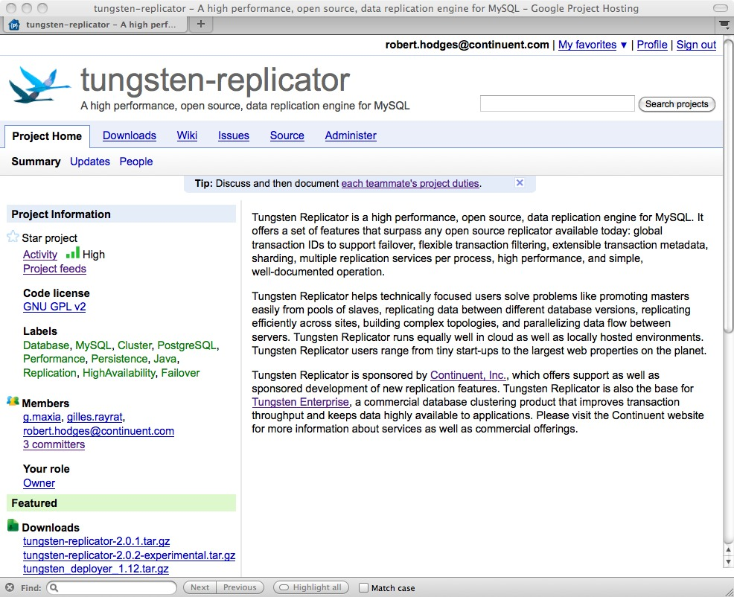
Home Sweet Home
http://code.google.com/p/tungsten-replicator

Slide 13
Tungsten Replicator Architecture
Master
(Replicator configuration)
Tungsten Replicator
(replicator)
replicator.
properties
MySQL
Tail binlog or login as client
Transport via TCP/IP connection
Binlogs
Transaction
History Log
(Transactions + Metadata)
Apply using JDBC
Transaction
History Log
Tungsten Replicator
(replicator)
MySQL
replicator.
properties
Slave

Slide 14
The Foundation: Consistent Copies
Application Server
Application Server
MySQL Client Library
MySQL Client Library
Application logic:
Is it current enough?
Application logic:
Is it current enough?
DBMS
DBMS
DBMS
Replicator
Replicator
Replicator
Slave
Master
Slave
Notes:
14

Slide 15
The Data Service:
Logical to Physical Mapping via the SQL Router

Slide 16
Data Service and Data Sources
A Rreplication Service represents a database-server-centric replication topology for Tungsten replicator
Without additional functionality, applications must be configured to connect to specific database servers at any given time
  What happens if there is a master failure?
  What happens if a slave is lagging too far behind?
  What happens if I add a new slave?
A Data Service represents a logical, application-centric view of a replication-service
  Organized as a set of Data Sources, each Data Source mapping to a physical database server with a specific role
  Decouples the logical role i.e. master and slave, from the physical location of the database server
  Applications specify the quality of service (QOS) they require when connecting

Slide 17
SQL Router
Maintains logical->physical mapping
Supports Quality-of-Service-based connectivity
  RW_STRICT
    Strict read/write consistency. Router interprets this as a request to connect to the master.
  RO_RELAXED
    With no other arguments, tells the router to connect to a slave if there is one available.
Round-Robin Read Load Balancing

Slide 18
Integrating SQL Router: Manual Operation
Application Server
Application Server
MySQL Client Library
Connector/SQL Router
MySQL Client Library
Connector/SQL Router
MySQL Client Library
MySQL Client Library
Router CLI
Is it current enough?
Is it current enough?
Data Service
DBMS
DBMS
DBMS
Replicator
Replicator
Replicator
Slave
Master
Slave
Notes:
18

Slide 19
Monitoring and
Complex Process Orchestration:
Manager/Monitor

Slide 20
Integrating Manager/Monitor
Application Server
Application Server
MySQL Client Library
Connector/SQL Router
MySQL Client Library
Connector/SQL Router
MySQL Client Library
MySQL Client Library
Router CLI
Monitoring and control
Data Service
Monitoring and control
DBMS
DBMS
DBMS
Replicator
Replicator
Replicator
Manager/
Monitor
Manager/Monitor
Manager/Monitor
Slave
Master
Slave
Notes:
20

Slide 21
Tungsten Enterprise
Application Server
Application Server
MySQL Client Library
Connector/SQL Router
MySQL Client Library
Connector/SQL Router
PostgresSQL Client Library
PostgresSQL Client Library
Monitoring and control
Data Service
Monitoring and control
DBMS
DBMS
DBMS
Replicator
Replicator
Replicator
Manager/
Monitor
Manager/Monitor
Manager/Monitor
Slave
Master
Slave
Notes:
21

Slide 22
Manager/Monitor Functional Diagram
Replicator
Replicator
SQL
Routers
Manager/Monitor
Replicator
Replicator mon plugin
MySQL
mon plugin
MySQL
Operational
Rules
Replicator
Replicator
facts
actions
SQL
Routers
Manager/Monitor
Replicator
monitor notifications and control requests in total order
Replicator mon plugin
MySQL
mon plugin
MySQL
Group
Communications
coordinator
Replicator
Replicator
SQL
Routers
Manager/Monitor
Replicator
Replicator mon plugin
MySQL
mon plugin
MySQL

Slide 23
SQL Router QOS Extensions
Replication monitoring information relayed to the SQL Router
  Allows for QOS extensions
    RO_RELAXED
      Can specify maxAppliedLatency=<seconds>. Router will only connect to a slave if it is current enough. Otherwise, it will connect to the master.
    RW_SESSION
      Must specify a ‘session id’ which acts like a ‘cookie’ for the router. The router tracks all writes by that session and ensures that any reads made by that session are strictly consistent with writes made by the session.
      Sessions are isolated from each other.
      ‘automatic’ sessions for USER, DATABASE and CONNECTION
      sessionId can be any string – PHP session ID for example

Slide 24
Session Load Balancing: Smart Scale
sessionId=a015c5
sessionId=c65a14
Write t1
Read t1
Read t1
Write t2
Read t2
Connector/SQL Router
Data Service
DBMS
DBMS
DBMS
Replicator
Replicator
Replicator
Manager
Manager
Manager
Slave
Master
Slave
Notes:
24

Slide 25
Performance: Smart Scale PHP Example
<?php
# Host where the Tungsten Connector is running
$host = “localhost”;
$port = 3306;
$username = “tungsten”;
$password = “secret”;
# Append the Tungsten SQL Router Quality Of Service to the database name.
# Use the PHP session id, which must have been created earlier, as the
# sessionId for the qos parameter. This works because PHP just passes the
# database name, unaltered, to the Tungsten Connector and is passed to
# the Tungsten SQL Router which strips off the arguments it understands.
#
$dbname = “admin?qos=RW_SESSION&sessionId=”.session_id();
# Make the connection
$connection = mysqli_connect($host, $username, $password, $dbname, $port);.
........ More application logic here .........
?>
Notes:
25

Slide 26
Tungsten Enterprise 1.3 Summary
Organizes a set of database servers into a single logical data service
Management, monitoring and replication are integrated and running on each database server host
A Data Service is highly-available and scalable
Failure detection and failover is orchestrated by the manager/monitor
Applications are isolated from failures, via router control, as they are detected
Tungsten connector provides connectivity to a single data service
Replication is single-threaded
Can be integrated with enterprise monitoring
Can be integrated with advanced disk subsystems like NetApp
MySQL Client Protocol Handler
JDBC
Tungsten SQL Router
Tungsten Connector
master
Data Source
slave
Data Source
slave
Data Source
Data Service
Advanced Storage
Subsystem

Slide 27
Tungsten Enterprise 1.3: Use Cases
Automatic failover
No-downtime promotion of a slave to a master (switch)
Simple read/write splitting, transparent to the application
Transparent scaling via routing of read operations to slaves using ‘Smart Scale’
In-service schema upgrades
No-downtime backups
No-downtime provisioning of slaves
MySQL Client Protocol Handler
JDBC
Tungsten SQL Router
Tungsten Connector
master
Data Source
slave
Data Source
slave
Data Source
Data Service
Advanced Storage
Subsystem

Slide 28

Automatic Failover
Application Server
Connector
SQL Router
Which slave is the most up to date?
Writes to master
Reads to slaves
DB2
Slave
DB1
Master
DB3
Slave
SQL
SQL
Master and Two Slaves online.
Notes:
28

Slide 29
Automatic Failover
Application Server
Connector
SQL Router
Which slave is the most up to date?
Writes to master
Reads to slaves
DB2
Slave
DB2
Master
DB1
Master
DB3
Slave
SQL
SQL
Master and Two Slaves online.
Notes:
29

Slide 30
Just around the Corner

Slide 31
Tungsten Enterprise 2.0
Key features to support multi-tenant applications
Allows for multiple data services for a given set of database servers
Advanced replication topologies including cross-service/cross-site and multi-master
Isolation of tenants from each other
Parallel replication is critical for supporting the ‘isolation’ requirement.
Tungsten connector must support multiple data services including data services that are at remote sites
Exposes ‘shards’ as a first-class entity: shard == database
  Applications can connect to specific shards
  Shards can be managed separately
MySQL Client Protocol Handler
JDBC
Tungsten SQL Router
Tungsten Connector
master
Data Source
master
Data Source
master
Data Source
shards
slave
Data Source
slave
Data Source
slave
Data Source
slave
Data Source
slave
Data Source
slave
Data Source
Data Service
Data Service
Data Service

Slide 32
Tungsten Enterprise 2.0: Use Cases
Location-independent routing of connection requests to shards via logical-to-physical translation
Isolation of shards at the replication level via parallel replication and quality-of-service constraints
Isolation of shards at the application level via quality-of-service constraints
Ability to move shards across data services including to a remote data service
Complex replication topologies supported, including multi-master/bi-directional
Disaster recovery via cross-site replication
MySQL Client Protocol Handler
JDBC
Tungsten SQL Router
Tungsten Connector
master
Data Source
master
Data Source
master
Data Source
shards
slave
Data Source
slave
Data Source
slave
Data Source
slave
Data Source
slave
Data Source
slave
Data Source
Data Service
Data Service
Data Service

Slide 33
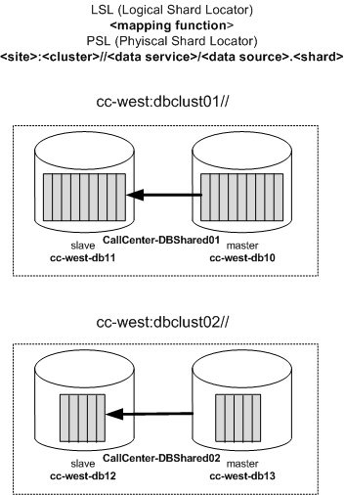
Tungsten 2.0: Data Service Definition
LSL: cc-mycustAAA-appdb1
PSL: cc-west:dbclust01//CallCenter-DBShared01/appdb1
# set up a data service to manage app databases
# automatically create a new shard for every DB
create dataservice dbclust01//CallCenter-DBShared01 (
master cc-west-db10,
slave cc-west-db11) shard on database
# set up another data service for more app databases
# automatically create a shard for every DB
create dataservice dbclust02//CallCenter-DBShared02 (
master cc-west-db12,
slave cc-west-db13) shard on database

Slide 34
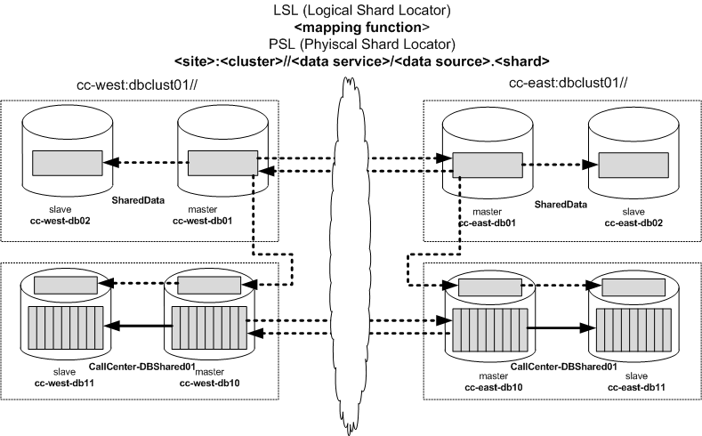
Tungsten 2.0: Complex Topologies
# Local data services on each site
create dataservice cc-west:dbcluster01//SharedData(master cc-west-db01, slave cc-west-db02);
create dataservice cc-east:dbcluster01//SharedData(master cc-east-db01, slave cc-east-db02);
# Composite data services define multi-master between local data services
create composite dataservice WestToEast(master cc-west:dbcluster01//SharedData, slave cc-east:dbcluster01//SharedData);
create composite dataservice EastToWest(master cc-east:dbcluster01//SharedData, slave cc-west:dbcluster01/SharedData);
# Local data service for multi-tenant data + composite service to replicate shared data.
create dataservice cc-west:dbcluster01//CallCenter-DBShared01(master cc-west0db11, slave cc-west-db12);
create composite dataservice WestShared01(master cc-west:dbcluster-1//SharedData, slave cc-west:dbcluster01/CallCenter-DBShared01);

Slide 35
Tungsten 2.0: Moving a Shard, Local
LSL: cc-mycustAAA-appdb1
PSL: cc-west:dbclust01//CallCenter-DBShared01/appdb1
M mv cc-mycustAAA-appdb1 dbclust01//CallCenter-DBShared02
The command does not use fully qualified data service name – context is inferred and assumed to be site-local.
Provisions a new composite slave for the cc-mycustAAA-appdb1 shard in the target data service. This means that we’ll have both a master and a slave for this shard on the target.
Replicates from the source data service to the target data service until the target data service is ‘nearly’ caught up.
Suspends any new application connections to the source shard and then does a flush of the source shard.
Waits for the source shard master to replicate the flush record.
Starts allowing new connections to the target shard. This implies that the connectivity layer will now translate the LSL for the shard to the new physical location
Optionally removes the data for the shard from the source
After the move, the shard master PSL is:
C cc-west:dbclust01//CallCenter-DBShared02/appdb1@cc-west-db13

Slide 36
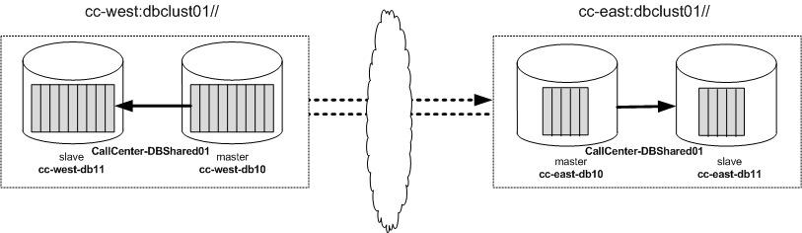
Tungsten 2.0: Moving a Shard, Remote
mv cc-mycustAAA-appdb1 cc-east:dbclust01//CallCenter-DBShared01
The high-level operations here are identical to the previous case.
After the shard is moved, the shard master PSL is:
cc-east:dbclust01//CallCenter-DBShared01/appdb1@cc-east-db10

Slide 37
Getting Started with Tungsten Today

Slide 38
Continuent Product Subscriptions
Per database server subscriptions for Tungsten Enterprise
  Pricing based on number of DBMS servers, not number of physical servers
Software-only –
  Tungsten Enterprise license
  Use hourly consulting for support; bug-fixes are free
Software + Support
  Tungsten Enterprise license
  24x7 guaranteed response time support (SLAs negotiable)

Slide 39
Continuent Consulting
Practical consulting by industry experts on any aspect of Tungsten or replication/clustering for open source databases
Hourly support contracts
  Advice, troubleshooting, bug fixes
Projects
  Cluster design, roll-outs, upgrades, special replication problems
Sponsored development
  Implementation of features large and small
  Actively seeking customers who want to build a private DBaaS
Offered for both Tungsten Replicator open source and Tungsten Enterprise commercial products

Slide 40
Contact Information
560 S. Winchester Blvd., Suite 500
San Jose, CA 95128
Tel (866) 998-3642
Fax (408) 668-1009
e-mail: sales@continuent.com
Continuent Web Site:
http://www.continuent.com
Tungsten Replicator Project
http://code.google.com/p/tungsten-replicator
Notes:
40
How do I get an eval copy of the software
Can you share any whitepapers on this technology?
What is the price?
Our dedicated server price is based upon CPU’s and the size of the cluster
The monthly subscription starts at $125 list for a 2 node.
Virtual Private Clusters are priced differently and I would be glad to discuss this off-line
Is the entire database kept in memory?
Can I make schema changes while the cluster is running
How do you differ from Veritas Cluster Server?

